Slide 1


November 2014
Gallup Pakistan
HR Newsletter
IN THIS EDITION
Page 3
Six Reasons Millenials are Actually the Best Workers
Reading Time: 2 mins
Page 5
How the Class of 2014 will find Jobs
Reading Time: 1.5 mins
Page 7
What Millennials Want And Why Employers Should Take Notice
Reading Time: 1.5 mins
*
gallup
enhancing performance through
empirical understanding of HR issues
* Disclaimer: Gallup Pakistan is not related to Gallup Inc. headquartered in Washington D.C. USA. We require that our surveys be credited fully as Gallup Pakistan (not Gallup or Gallup Poll). We disclaim any responsibility for surveys pertaining to Pakistani public opinion except those carried out by Gallup Pakistan, the Pakistani affiliate of Gallup International Association. For details on Gallup International Association see website: www.gallup-international.com

Slide 2





to Gallup Pakistan’s 3rd edition of a series of HR Newsletter. In this series we principally aim to encourage empirical understanding of HR problems faced by organizations today. By disseminating international and local research findings, Gallup Pakistan aspires to create a knowledge hub that HR practitioners in Pakistan can benefit from. In this regard, we would be borrowing extensive research from other member countries as well.
So, starting our journey, in this edition we endeavor to think beyond the misunderstandings surrounding the Millennial Generation (the people born between 1980 and 2000) and their performance as workforce. Our first article is borrowed from Forbes, which discusses 6 reasons why Millenials may be the best generation of workers. Our second article is an extract from The Fast Company which sheds light on how the Class of 2014 will find jobs. And our third very interesting article is borrowed from LinkedIn, which guides companies on what Millennial workers expect from businesses.
Don’t forget, your valuable suggestions and ideas are much waited for and appreciated. Also, we are open for partnerships with other teams working in similar domain. We look forward to a successful beginning.
Gallup Pakistan Team
Welcome
1
Bilal Gilani
Umar Taj
Maham Saleem
Malika Shahbaz

Slide 3
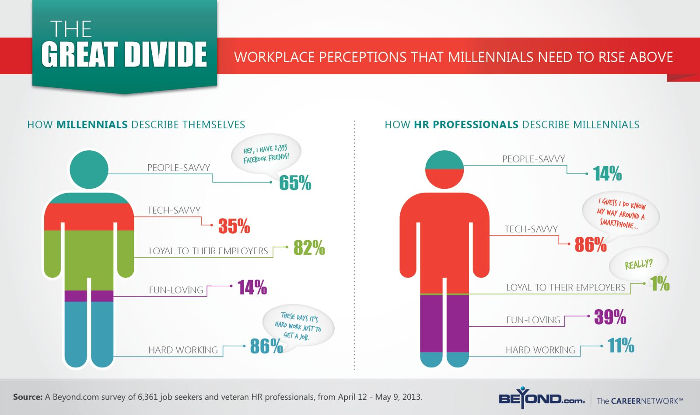
2

Slide 4
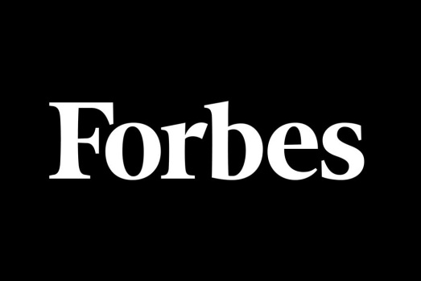
6
Contributor: Sanjeev Agarwal, former head of Product Marketing at Google and founder of Collegefeed
Six Reasons Millenials are Actually the Best Workers*
Millennials are the generation of individuals born between 1980s and early 2000s. Also known as Generation Y, this is the group that forms the biggest chunk of the hired workforce today as fresh graduates. Hence it is highly appropriate that we rise above the trend of trashing the work ethic and attitude of Millenials in the workplace that has become all too common lately and instead move on to a reasonable evaluation of their potential. This may lead companies, especially small companies and start-ups, to understand the worker they are hiring and derive the best value out of them.
Old is Not Necessarily Gold…
Many may disagree, but Sanjeev Agarwal asserts with confidence that Millenials may just be the best generation of workers that has been produced in a while. He says this having a strong 20 years worth of experience in hiring hundreds of fresh college graduates for well-reputed companies. Here are 6 reasons why you should start paying attention to this new breed of workers:
1. Resilient
2. Better communicators
3. Fast- paced
4. Fulfillment over money
5. Diverse
6. Technologically sound
*This article has been extracted from Forbes Online resource and can be accessed at:
http://www.forbes.com/sites/forbesleadershipforum/2014/05/16/six-reasons-millennials-are-actually-the-best-workers/
3

Slide 5
1
Are They Too Overconfident and Cocky?
Today’s young job seekers have grown up with a startup mentality and embracing failure has been etched into their psyche. They approach positions with the understanding that they may have to put in 110% to succeed, even with the near certainty that their employer won’t be around five years from now. It’s true that many baby boomer parents have raised them with a perspective of possibility. They’ve been encouraged to follow their dreams and passions. So where some see entitlement, we see greater authenticity and audacity. Millennials will shoot for the stars—and if they fall down, they’ll get right back up and try it a different way.
2
What if They Don’t Communicate the Way You Do?
While many offices struggle to get their workforce to embrace new services like Yammer or Basecamp, Millennials have been doing those things for years. They’ve been learning with social classroom tools and chatting on Facebook, Twitter, and Instagram every waking hour. As a result, they actually conceive of communication in a one-to-many paradigm, which is a huge plus for companies that are spread out globally and interact primarily in a virtual environment.
3
Are They Too Fast- Paced?
With the pace of news, communication, and responsiveness nearly instant, that’s how they approach work. They know nothing else. Plus, they have the necessary tools to support them. Give a millennial employee a research assignment on your competitors and you’ll get the project back in 24 hours. Twenty years ago the same project might have taken a month to complete. One piece of advice: Just make sure you attach a deadline to the assignment.
4

Slide 6
4
Do They Expect Too Much?
Studies show that young job seekers today are passionate about how their jobs affect the world. In fact, they value job fulfillment over monetary reward. What does that mean for employers? I would hope it could open the doors to two things. First, we have the ability to retain skilled and valuable millennial workers by creating environments where social impact is lauded. That will reduce employee turnover and save companies thousands of dollars each year in recruiting, hiring, and lost productivity. More important, Millennials are a driving force towards significant, scalable, and lasting social change that will benefit everyone.
5
What If They Think Differently Than You?
Millennials don’t just embrace diversity on the job; they expect it. From race and religion to gender and sexuality, they’ve come of age with a greater comfort of multiplicity of all kinds. Imagine how that translates in the workplace. The payoffs touch every single area of a business by opening the doors to increased creativity, agility, and productivity, new attitudes and language skills, a more global understanding, new solutions to difficult problems, stronger customer and community loyalty, and improved employee recruitment and retention.
6
Is Their Obsession With Technology Bad?
Millennial workers are the bridge to that future, through social media, mobile, the cloud, and other real-time technologies that haven’t even been invented yet. They are graduating with both academic skills and innate behavioral skills that companies will need to engage with customers in much more meaningful (and profitable) ways.
5

Slide 7

Contributor: Rachel Gillett
How the Class of 2014
Will Find Jobs*
Millennials have great expectations entering the workforce this year, but it's not just about meeting those expectations when it comes to winning top recruits; how you get your company in front of job seekers is just as important. Even though you may feel your company can satisfy much of what potential hires are looking for, how graduates conduct their job search will affect whether or not you show up on their radar. A recent article by Fast Company provides some handy guidelines.
MAKING A GOOD FIRST IMPRESSION
With company review sites like glassdoor.com, brand presence on social media sites like Facebook and Twitter, and LinkedIn company pages, there is an inordinate amount of information available to savvy job seekers looking for their ideal company. With this data at their disposal, it’s so easy for potential hires to head straight to the source and apply directly through a company’s
career page.
This is why it’s so important to have a strong employer brand: if job seekers don’t know who you are, they’re not going to come looking for you. And if they have heard about you, and not in the good way, then consider this an opportunity to address the negativity and build a better social reputation.
MILLENIALS AREN’T AS TECH-OBSESSED AS YOU MIGHT THINK
Sure, Millennials have a reputation for having grown up in a hyperconnective era, but the value of making personal connections isn’t lost on the class of 2014.
Networking events, campus career services, and friends’ connections fill the No. 2, 3, and 4 slots on how Millennials plan to find jobs.
Companies like Google and Facebook use this preference to their advantage and host hackathons at
5
5
* This article has been extracted from :
http://www.fastcompany.com/3031513/the-future-of-work/where-the-class-of-2014-is-turning-for-jobs

Slide 8

some of the top universities, a genius means for recruiting the cream of the coding crop.
Targeting the ideal universities for the kind of recruits they need and building a presence on campus is key for companies looking for the top recruits. By sponsoring networking events, participating in career days, and integrating into the things that are already happening on campus, companies can use personal connections to take their pick.
JOB BOARDS ARE OUT, LINKEDIN IS . . . IN
LinkedIn has seen a steady incline, as the site has grown to offer more than simply job postings and a place to keep your resume. Not surprisingly, then, 28% of students said they would look for their post-college job on LinkedIn.
Today there are more than 39 million students and recent grads and 24,000 universities using the site. Students and graduates can use the Alumni tool under their University Page to see where fellow graduates live, the organizations they work for, and the types of jobs they pursue. Grads can also explore fellow alumni’s careers based on what they studied, their top skills, and how they are connected on LinkedIn.
6

Slide 9
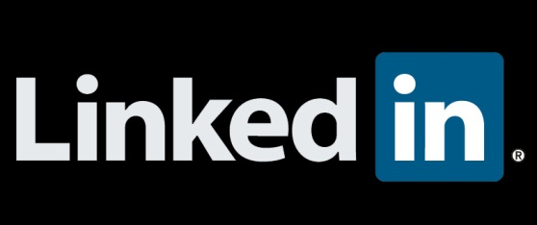
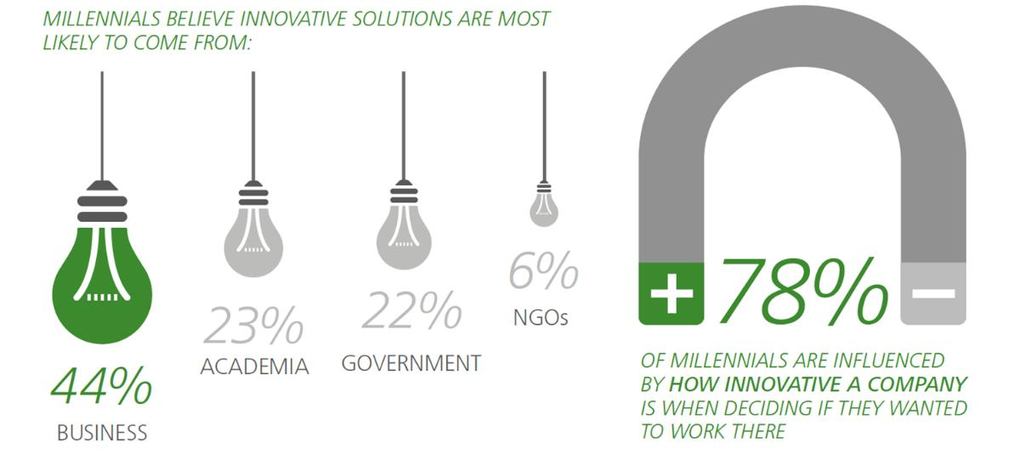
Contributor: Barry Salzberg, Global CEO, Deloitte Touche Tohmatsu Limited
What Millennials Want & Why Employers Should Take Notice: 5 Pointers*
As the leader of a major international organization (with more than 200,000 employees) Barry Salzberg is particularly interested in finding out the expectations Millenials have for their careers. Case- in- point: what does the Millennial generation want to be when it grows up? A new survey of Millennials (born January 1983 onwards), conducted globally by Deloitte Touche Tohmatsu Limited provides some intriguing insights:
1. Millennials Expect Businesses To Care:
They think business can do much more to address society’s challenges in the areas of most concern: resource scarcity
68 % climate change 65% and income equality 64%.
2. Millennials Want To Be Innovative
78% of Millennials were influenced by how innovative a company was when deciding if they wanted to work there, but most say their current employer does not do enough to encourage them to think creatively.
*This article has been extracted from Forbes Online resource and can be accessed at:
https://www.linkedin.com/today/post/article/20140122180239-27058877-what-millennials-want-and-why-employers-should-take-notice
7

Slide 10
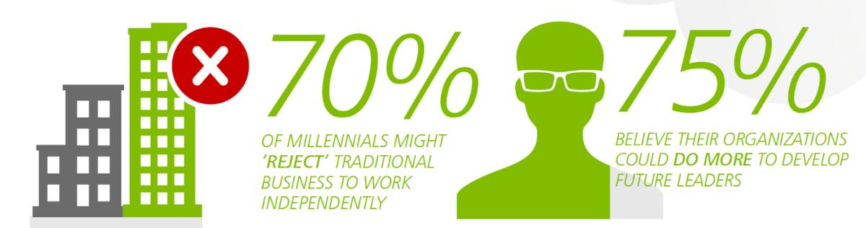
3. Millennials Want To Be Leaders:
Almost one in four Millennials are ‘asking for a chance’ to show their leadership skills. Additionally,
75% believe their organizations could do more to develop future leaders.
4. Millennials Want To Make A Difference:
Millennials believe the success of a business should be measured in terms of more than just its financial performance. Millennials participate in ‘public life:’ 63% of Millennials gave to charities, 43% actively volunteered or were a member of a community organization and 52% signed petitions.
5. Millennials Are Ready To Go Their Own Way:
Roughly 70% of Millennials see themselves working independently at some point, rather than being employed within a traditional organizational structure. So make sure you retain the Millennials!
8

Slide 11



Copyright
The materials quoted in this newsletter have been picked from various internet sources. All possible attempt has been made to make sure that no copyrighted material is used in this document. In case if there is an issue relating to Copyright, the publishers of this newsletter will be happy to remove the content immediately.
Disclaimer
Gallup Pakistan is not related to Gallup Inc. headquartered in Washington D.C. USA. We require that our surveys be credited fully as Gallup Pakistan (not Gallup or Gallup Poll). We disclaim any responsibility for surveys pertaining to Pakistani public opinion except those carried out by Gallup Pakistan, the Pakistani affiliate of Gallup International Association. For details on Gallup International Association, see website: www.gallup-international.com
IN NO EVENT SHALL Gallup Pakistan OR ITS AGENTS OR OFFICERS BE LIABLE FOR ANY DAMAGES WHATSOEVER (INCLUDING, WITHOUT LIMITATION, DAMAGES FOR LOSS OF PROFITS, BUSINESS INTERRUPTION) ARISING OUT OF THE USE OF OR INABILITY TO USE THE MATERIALS.
As a user of this report, you acknowledge and agree that any reliance upon, or use of any information made available through this Report shall be entirely at your own risk. Subject to any implied terms which cannot be excluded by law, Gallup Pakistan and its related entities (including any directors, officers, employees and agents) shall not be liable for any loss or damage, whether direct or indirect, and however caused, to any person arising from the use of (or reliance upon) information provided on and made available through this Report.
Please send all correspondence to
HR Newsletter Editorial Team,
Email: isb@gallup.com.pk
Join us to stay updated
www.gallup.com.pk

